Slide 1
Linux Commands
Aleeta Davis
166743

Slide 2
File Commands
ls Directory listing
ls -a Lists all hidden files
cd dir Change directory to dir
touch file_name Creates a new file
pwd Show current working directory
mkdir dir Creating a directory dir
cat filname Displays content in the file
rm file_name Removes a file
rm -f filename Forcefully removes a file
rm -r directory_name Removes a directory recursively
mv file1 file2 Moves/Renames file1 to file2
cp -r dir1 dir2 Recursively Copies dir1 to dir2
cp file1 file2 Copies the contents of file1 to file
(create dir2 if not present)

Slide 3
System
date Show the current date and time
cal Show this month's calender
whoami who you are logged in as
cd .. Move up one level in the directory tree structure
cd Change directory to $HOME directory
cd /test Change directory to /test directory
echo hello gives the output hello

Slide 4
File Permissions
chmod u+rwx file1 : gives read(r),write(w),execute(x) permissions for user in file 1.
chmod g-rx file1 : removes read(r) and execute(x) permissions for group in file 1.
chmod go-w file1 : removes write(w) permissions for group in file 1.
chmod a=rwx file1 : sets all permissions to owner,group and others.
chmod -R u-wx dir1 : : removes write(w) and execute(x) permissions for user in dir1.

Slide 5
File Permissions
chmod octal filename : Change file permissions of the file to octal
Example :
chmod 777 /dir1/file1 :Set rwx permissions to owner, group and everyone (everyone else who has access to the server)
chmod 755 /dir1/test1 : Set rwx to the owner and r_x to group and everyone
chown user1 file1 : Changes ownership of file1 to user2
chown user:groupowner file/dir : changes group ownership

Slide 6
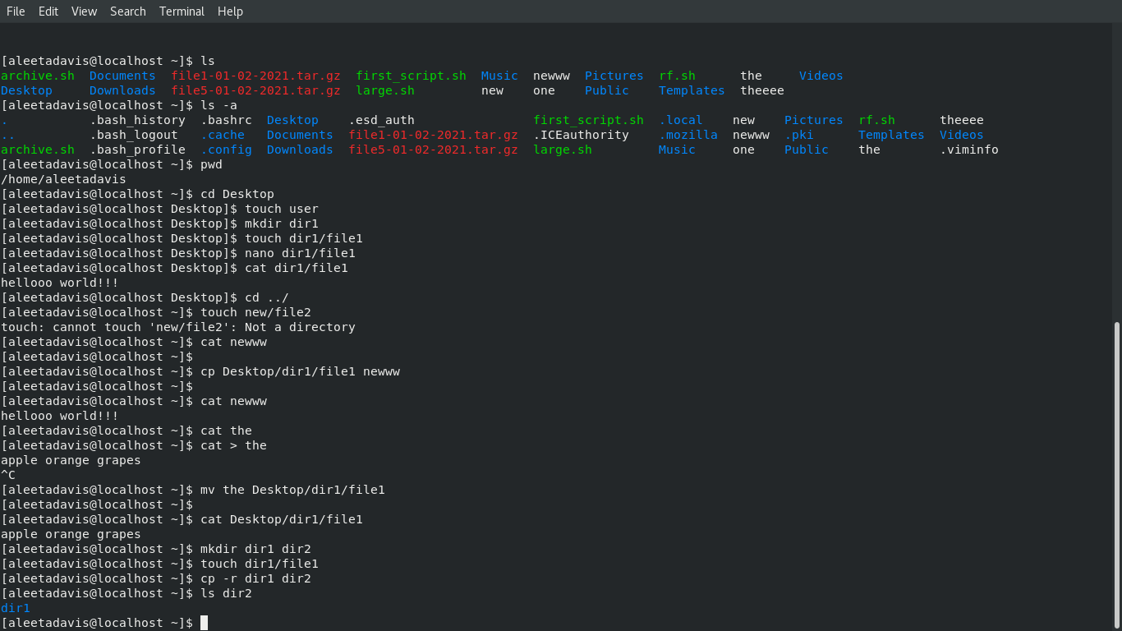

Slide 7
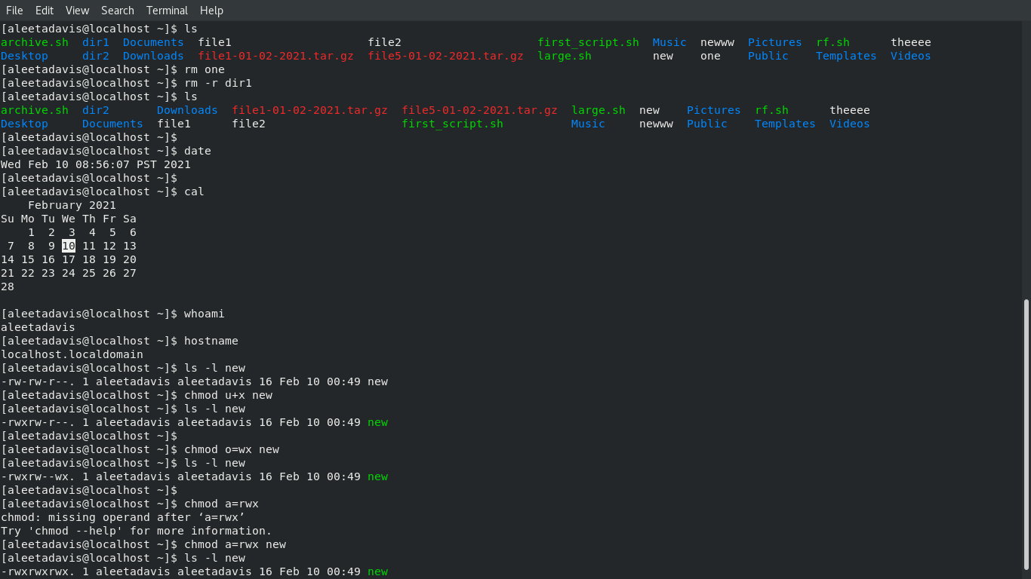

Slide 8
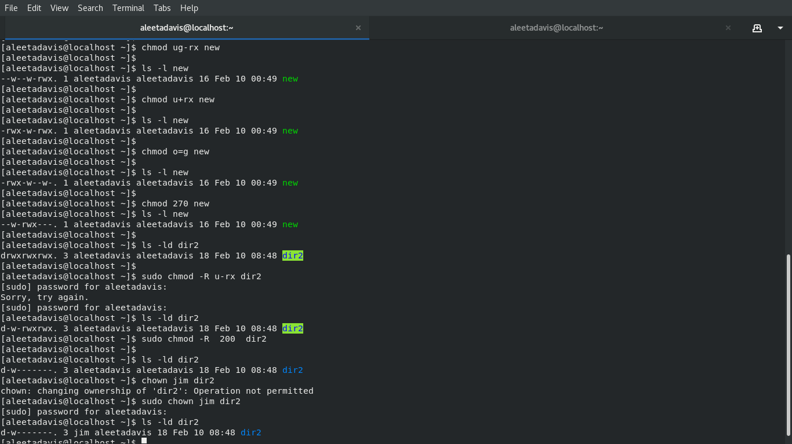

Slide 9
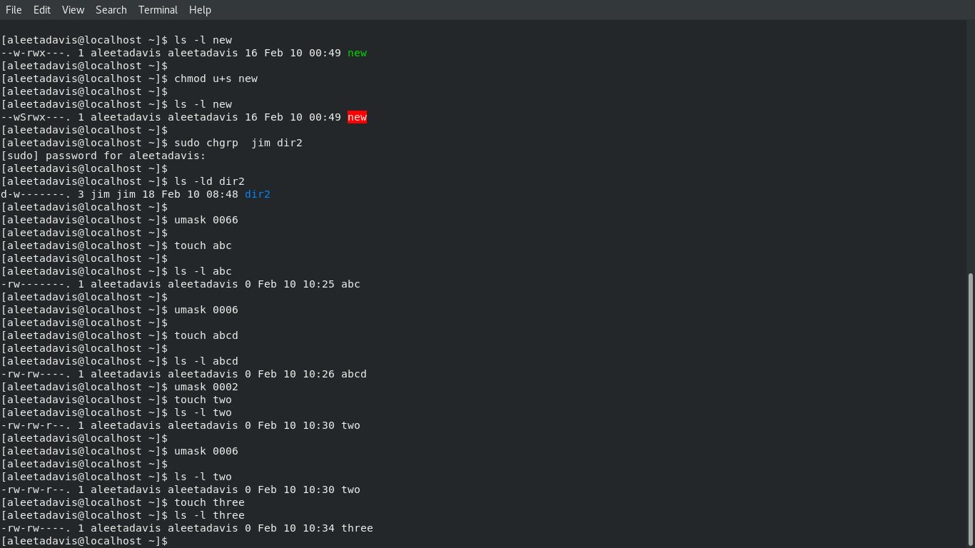

Slide 10
Thankyou

